Slide 1


A
Project Presentation On
HOUSE PRICE PREDICTION SYSTEM
Guru Ghasidas Vishwavidyalaya, Koni
Bilaspur, Chhattisgarh
May-2025
PRESENTED BY :
Shalini Gavel
B.Sc (Hons) CSIT
VI Sem
GUIDED BY :
Mr. Shreemat Das
Asst. Professor
Dept. of CS & IT

Slide 2
INTRODUCTION
In a dynamic real estate market, accurately estimating property values is invaluable for buyers, sellers, and investors alike. This project leverages the power of various machine learning algorithms to analyze key features of houses, such as size, location, number of bedrooms, and more, to build a robust predictive model. By understanding the underlying patterns and relationships within housing data, we aim to provide insightful and reliable price estimations, ultimately bringing more transparency and informed decision-making to the real estate landscape. Let's delve into the methodology, findings, and potential impact of this work.A user-friendly web interface is built using Streamlit for real-time predictions.

Slide 3

🔧 SOFTWARE REQUIREMENTS :
Python 3.8+: a high level, interpreted programming language required for running the core code.
Libraries : pandas (python library used for data manipulation and analysis) , scikit-learn (ML library for python), streamlit (open-source app framework for creating data apps using python), pickle (python module that helps in saving trained models to disk and loading them back for prediction without retraining).
Operating system : environment on which software runs (windows, linux, macOS).
Web Browser : Software application to access information on the World Wide Web.

Slide 4
💻 HARDWARE REQUIREMENTS :
Minimum 4 GB RAM: 4 GB is the minimum requirement for smoothly running the software and handling small to moderate datasets.
Intel i3 Processor or Above : it is a type of CPU (Central Processing Unit) developed by Intel, suitable for basic computing tasks. It ensures the machine has enough processing power to execute the program without lag or delays.

Slide 5
OBJECTIVE
Develop a Machine Learning Model for price prediction.
Utilize real-world housing data.
Create a user-friendly interface.
Enable smart decision-making in real estate.
Promote automation and digital transformation.
Achieve high accuracy and performance.

Slide 6
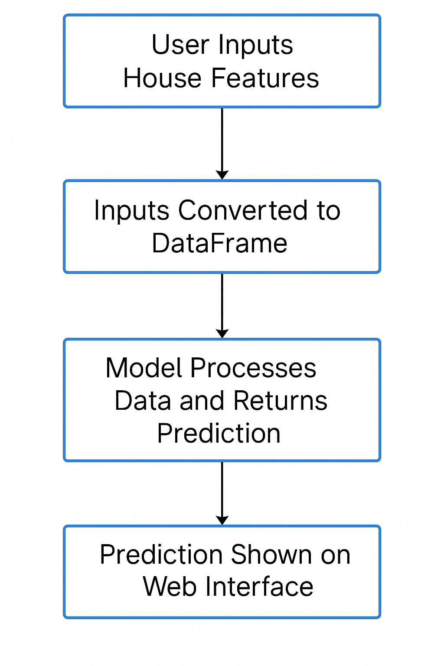
DATA FLOW
User inputs house features (location, soft, bedrooms etc.)
Inputs are converted to a DataFrame
Model processes the data and returns predictions.
Output is shown on the web interface.

Slide 7
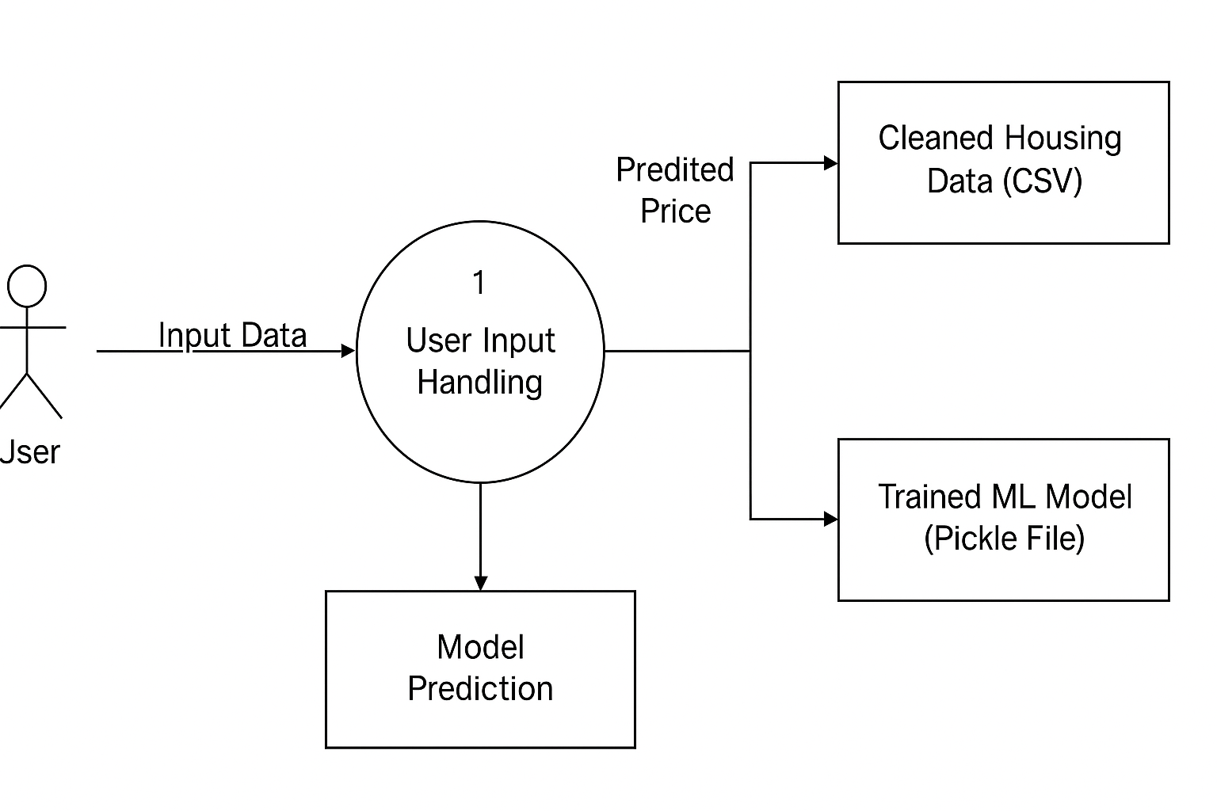
LEVEL 1 - DFD

Slide 8
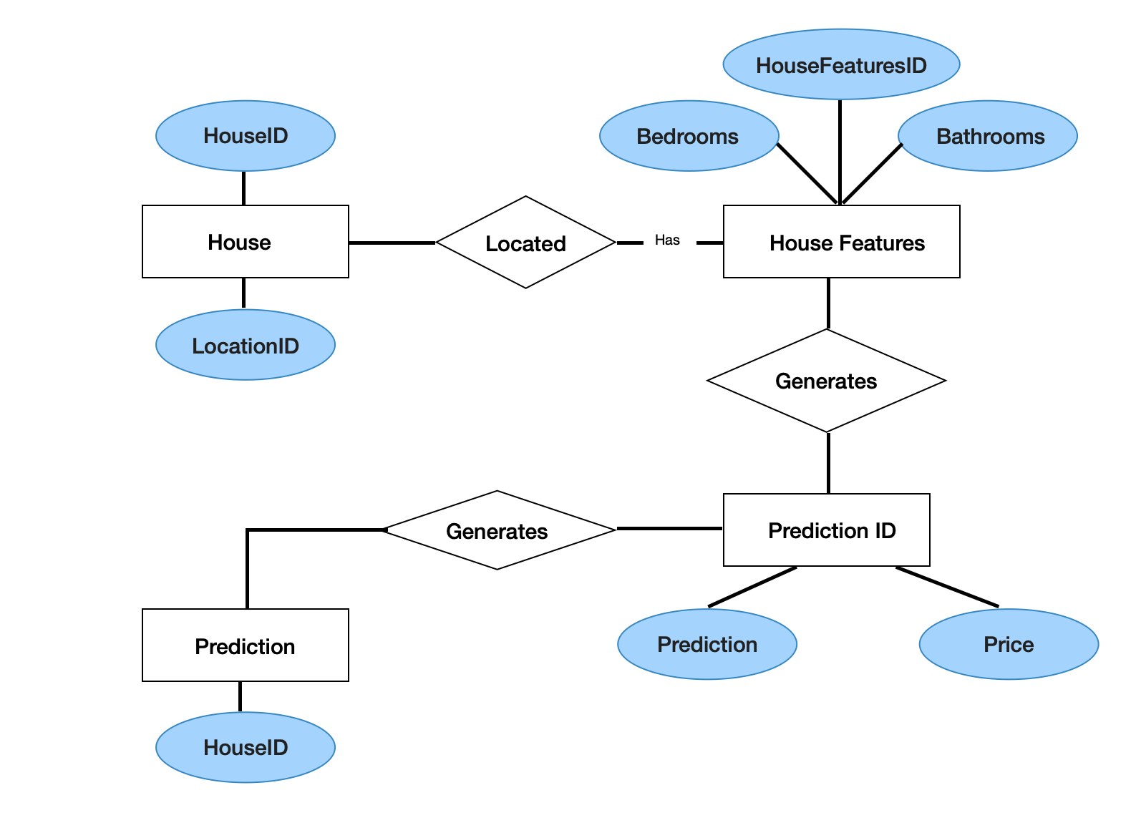
ER DIAGRAM

Slide 9
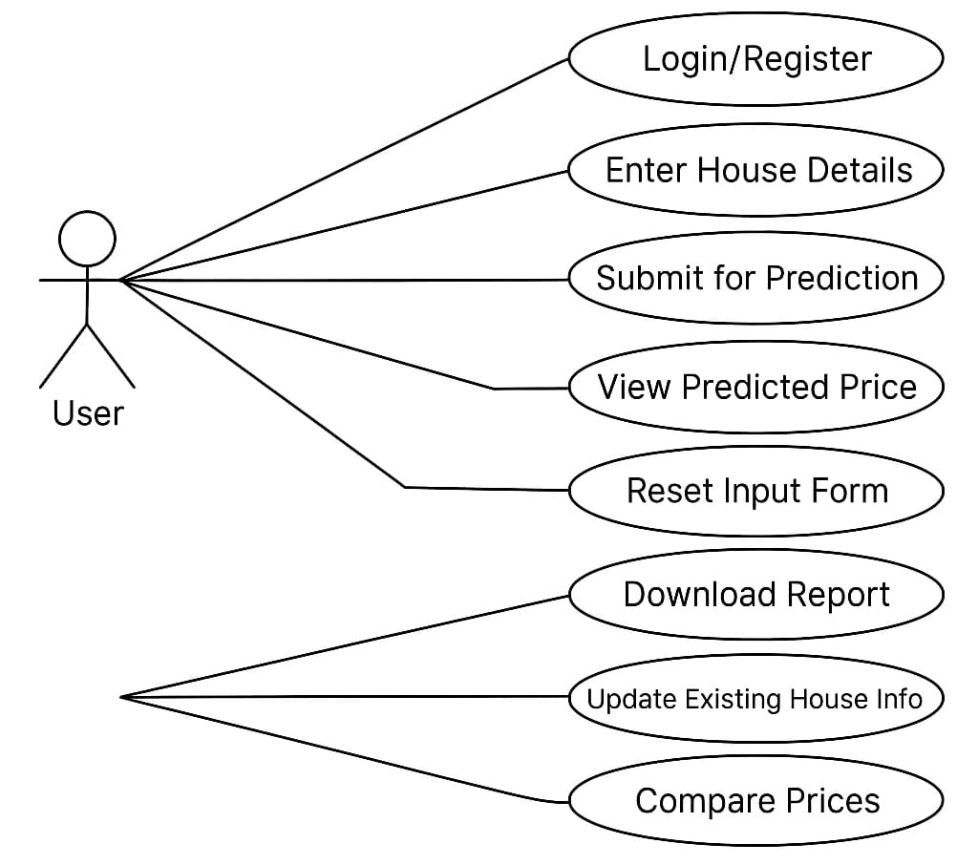
USE CASE DIAGRAM

Slide 10
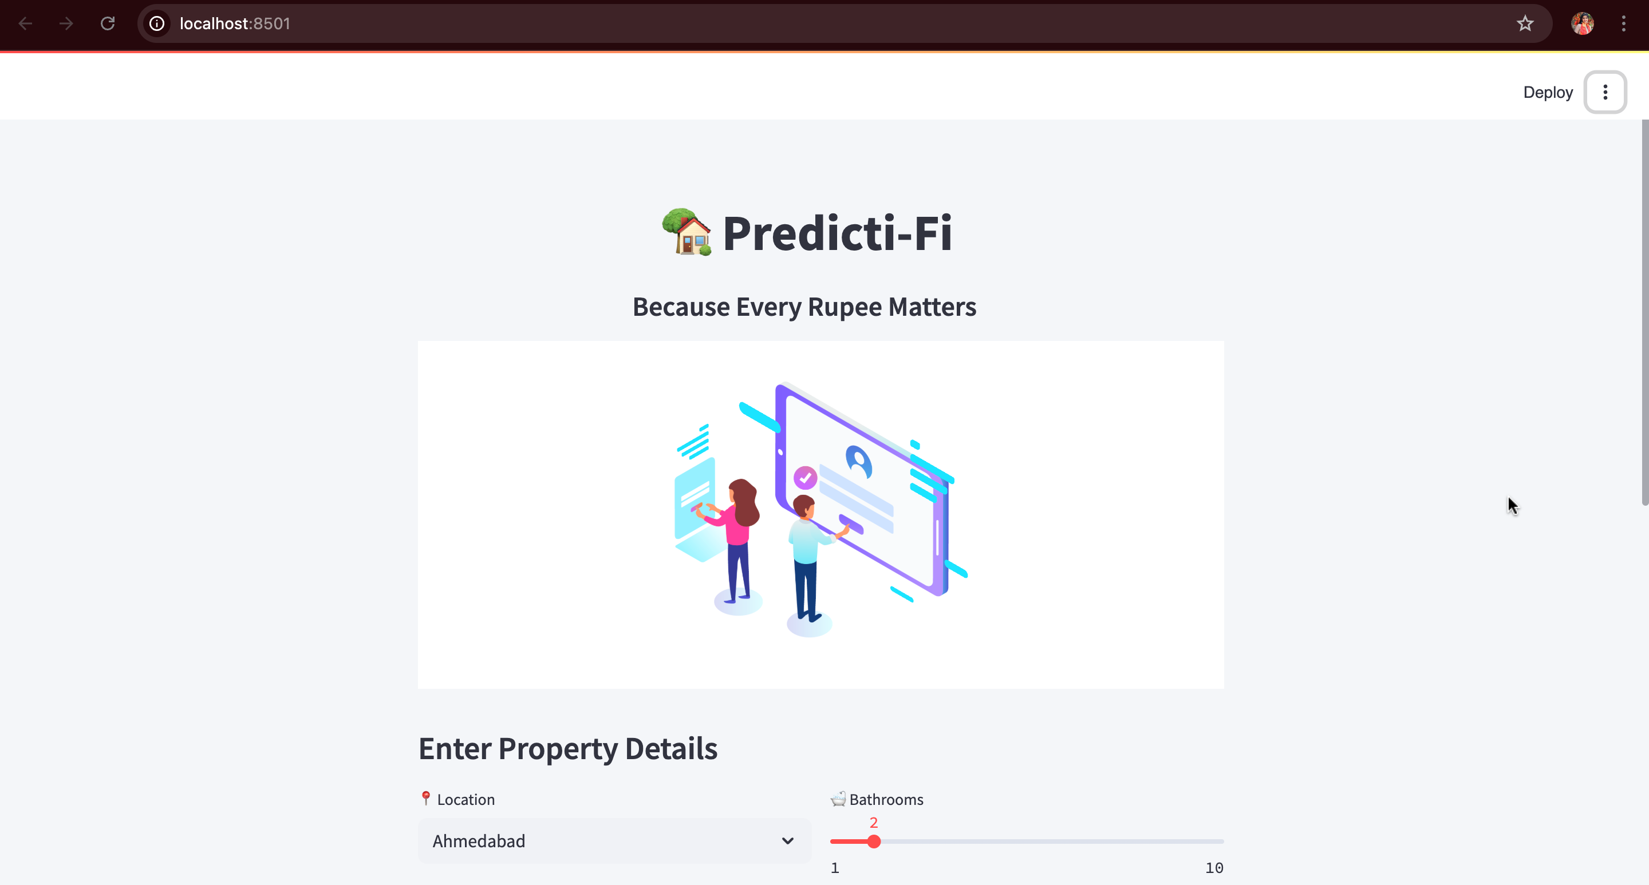
HOMEPAGE

Slide 11
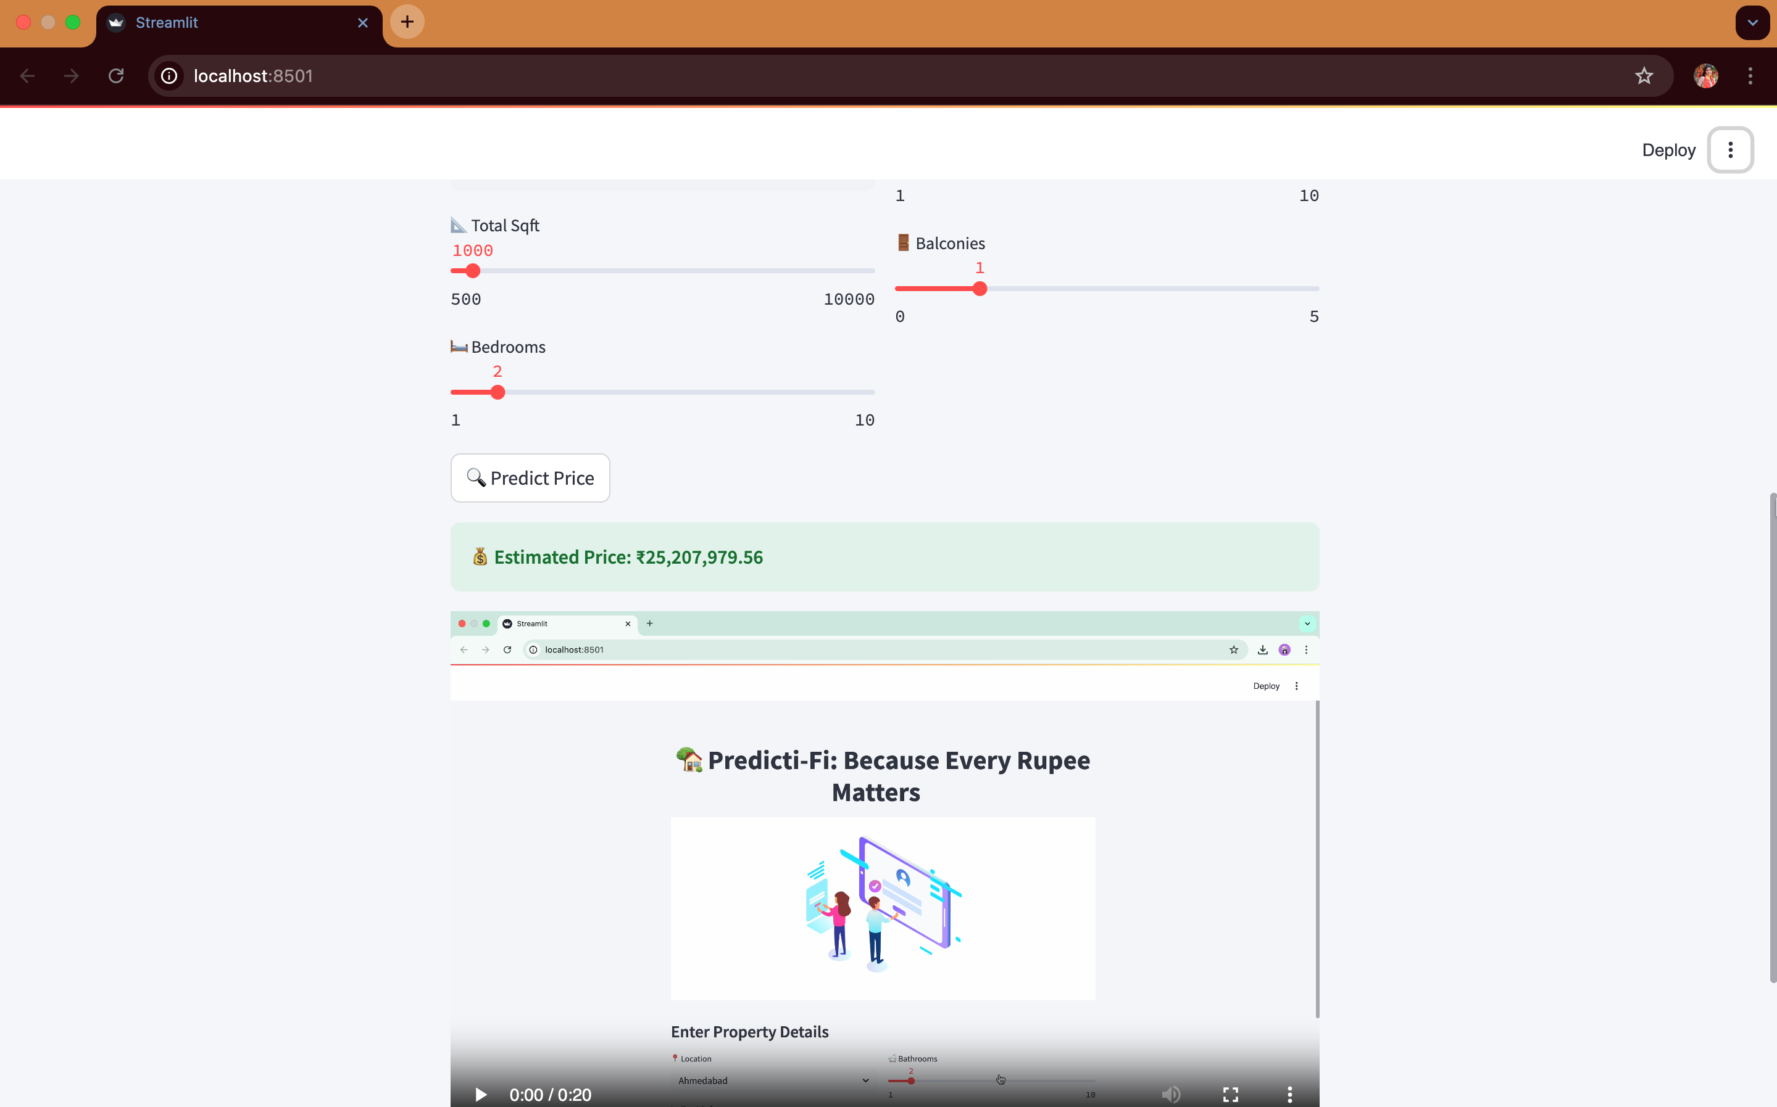
HOMEPAGE

Slide 12
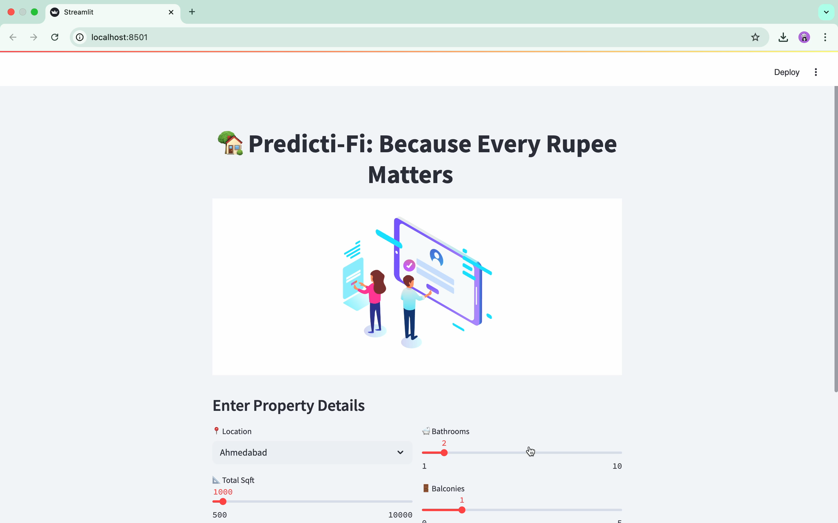
VIDEO SAMPLE

Slide 13
ADVANTAGES
✅Accurate predictions : uses a trained ML model to provide reliable and data-driven house price estimates.
⚡️Fast & Efficient : instant predictions with just a few clicks.
🌐Accessible anywhere : as a web-based solution, it can be accessed from any device with internet connectivity.
🔄Easily upgradable : new features like additional data points, charts, or mapping tools can be added with minimal efforts.
💸Cost effective solution : eliminates the need for expensive third-party valuation services, making it budget-friendly.
🔒Secure & private : operates locally or on secured servers.
📊Data-driven insights : leverages historical data to make informed predictions, reducing bias and guesswork.

Slide 14
CONCLUSION
In conclusion, this project demonstrates the effective integration of machine learning techniques with user-friendly interfaces to solve real-world problems. Looking ahead, there is significant potential for enhancing the application's functionality—such as incorporating more advanced algorithms, expanding data sources for improved accuracy, and enabling real-time analytics.
Future development could also focus on deploying the application at scale, optimizing performance for larger datasets, and adding mobile compatibility. With continued innovation and refinement, this project can evolve into a powerful tool with broader applications across various domains, driving impactful decision-making and automation.

Slide 15
“The success of this project is shared with all who offered their guidance and support.”
THANK YOU !

